Slide 1

www.diba.co.za

Slide 2


Table of Contents
About
Services
Accreditations & Registrations
Client Reviews
Contact
www.diba.co.za

Slide 3


Introduction
Who We Are
Diba BES is a 100% black women-owned South African company, established in 2005. We offer expert services in Building & Civil Construction, Built Environment Consulting, Occupational Hygiene Services and Accredited OHS training.
Vision
To deliver integrated construction solutions that drive quality and success for our clients.
Mission
To help clients deliver on-time, high-quality projects that benefit current and future generations.
Core Values
We are guided by quality, client satisfaction, safety, integrity, and innovation in everything we do.
www.diba.co.za

Slide 4

Services

Slide 5

Accreditations & Affiliations
NHBRC: Registered and compliant home builder.
CIDB: Accredited construction company meeting national industry standards.
SAFMA: Corporate member, showcasing our facilities management expertise.
SAPCA: Certified for professional pest control services.
NCCA: Accredited for quality cleaning and hygiene services.
SETA Accredited: Approved provider of OHS training, aligned with HWSETA and SACPCMP standards.
www.diba.co.za

Slide 6
Client Reviews
Ms B Malope
​Diba BES has worked on a variety of projects and has regularly outperformed competitors in terms of meeting deadlines and keeping a high degree of quality.
We would have no hesitation in recommending their services
to others.
​
City of Joburg Property
Company SOC
Mr. G. Matanga
Working with Diba BES Developments was a fantastic experience. Their team was professional, communicative, and delivered our project on time and within budget. The quality of their work speaks for itself. If you're looking for a construction company you can trust, look no further.​
​​​​​Department of
Waterand Sanitation
Ms. L. Mendoza
Diba BES exceeded our expectations with their exceptional construction services. From the initial consultation to project completion, their team was thorough, knowledgeable, and dedicated. They turned our ideas into a beautifully constructed reality. Highly recommend! ​
Township Independent Development Trust

Slide 7
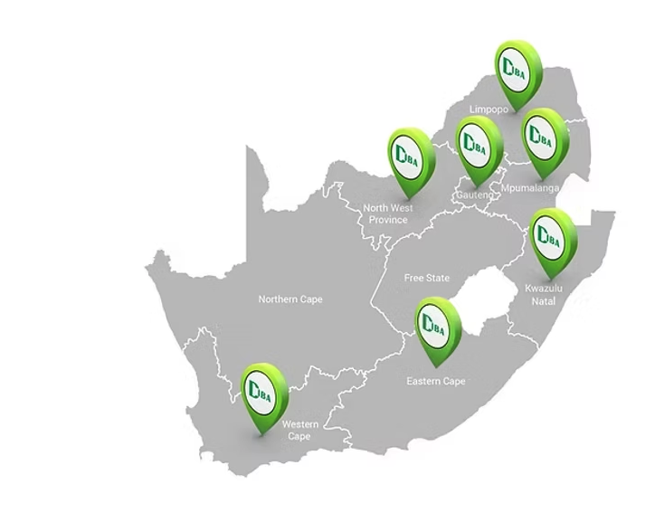

Introduction
Head Office (Gauteng):
No. 29 Jakkalsbessie Avenue, Heuweloord, Centurion, 0157
Tel: 012 658 0722
Email: info@diba.co.za
Gauteng
No 29 Jakkalsbessie Avenue
Heuweloord
Centurion
0157
info@diba.co.za
012 658 0722
086 501 2160
Limpopo
17a Magazyn Street
Polokwane
0700
​
​​
lp@diba.co.za
015 295 3771
086 501 2160
Mpumalanga
Regus Business Centre
11 Van Der Merwe Street
Nelspruit
1200
​
mp@diba.co.za
013 754 7756
086 501 2160
Kwazulu Natal
35 Braemar Street
Lalucia
Durban
4153​
kzn@diba.co.za
031 562 0078
086 501 2160
North West
214 Beyers Naude Dr
Rustenburg
0299
​
nw@diba.co.za
071 773 5880
086 501 2160
Western Cape
20 Klipspringer Street
Soneike
7580
​
wc@diba.co.za
072 618 5001
086 501 2160
Eastern Cape
242 Kalashe Drive,
Coverock Country Estate,
East London
​
​
info@diba.co.za
072 618 5001
086 501 2160

